Slide 1
Sign in
Register
ArtKick
Explore, Discover, Share
Swipe left

Slide 2
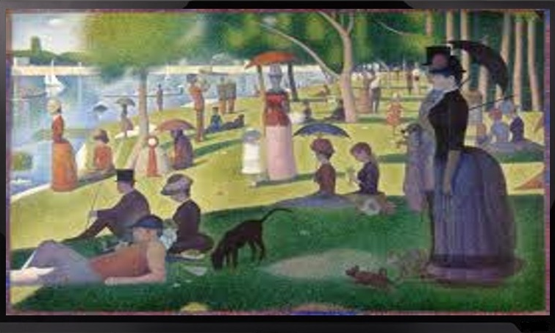
Sign in
Register
Great Art on your Walls
Use the HDTVs you own to display the world’s greatest art. Choose images to meet your every mood and desire.

Slide 3

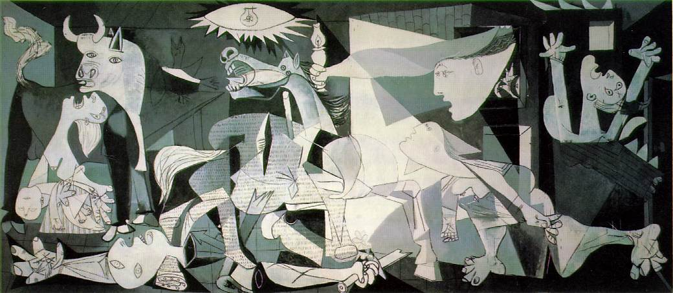
Sign in
Register
Guernica, 1937 by Pablo Picasso (Spanish, 1881-1973)
Change Images Instantly
Time for a new picture? Swipe your smartphone or tablet to change the image. Explore thousands of images and discover the ones you love.

Slide 4



Sign in
Register
Share with Friends
Share your favorite images and find new ones from your personal network.

